Slide 1

DevOps Fundamentals
Serhii Chernukha
TDF01-1

Slide 2
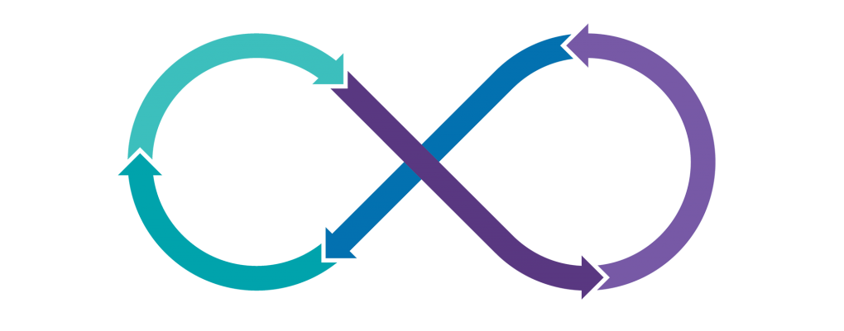

Software development methodologies

Slide 3

AGENDA
Introduction
Code and Fix
Waterfall
V-Model
Incremental Model vs Iterative Model
Spiral Model
Agile Model:
- Scrum
- Kanban

Slide 4
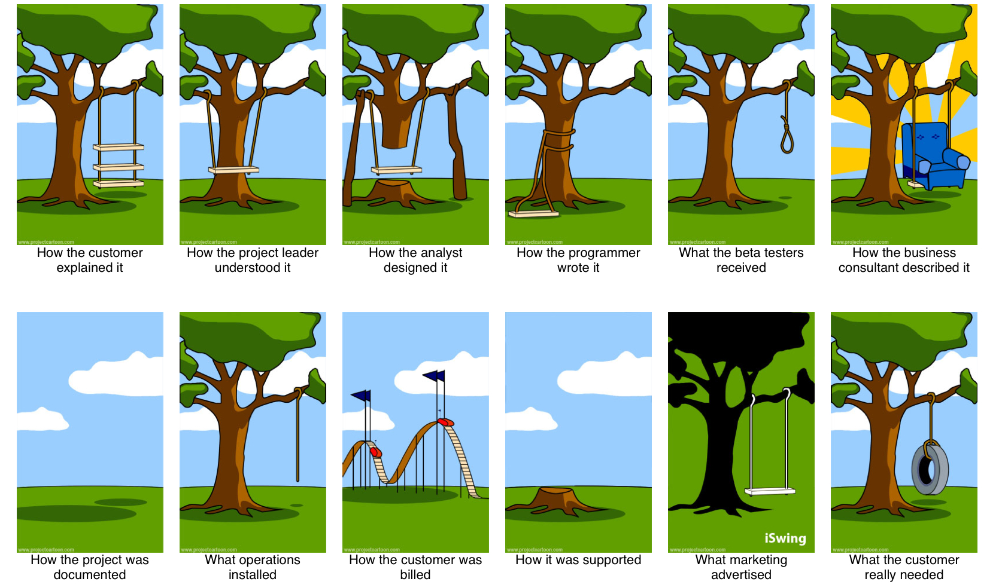
INTRODUCTION

Slide 5

INTRODUCTION

Slide 6
Code and Fix
<Code/>
No
Yes
Customer satisfied?
Bugs
fixing
Product done

Slide 7
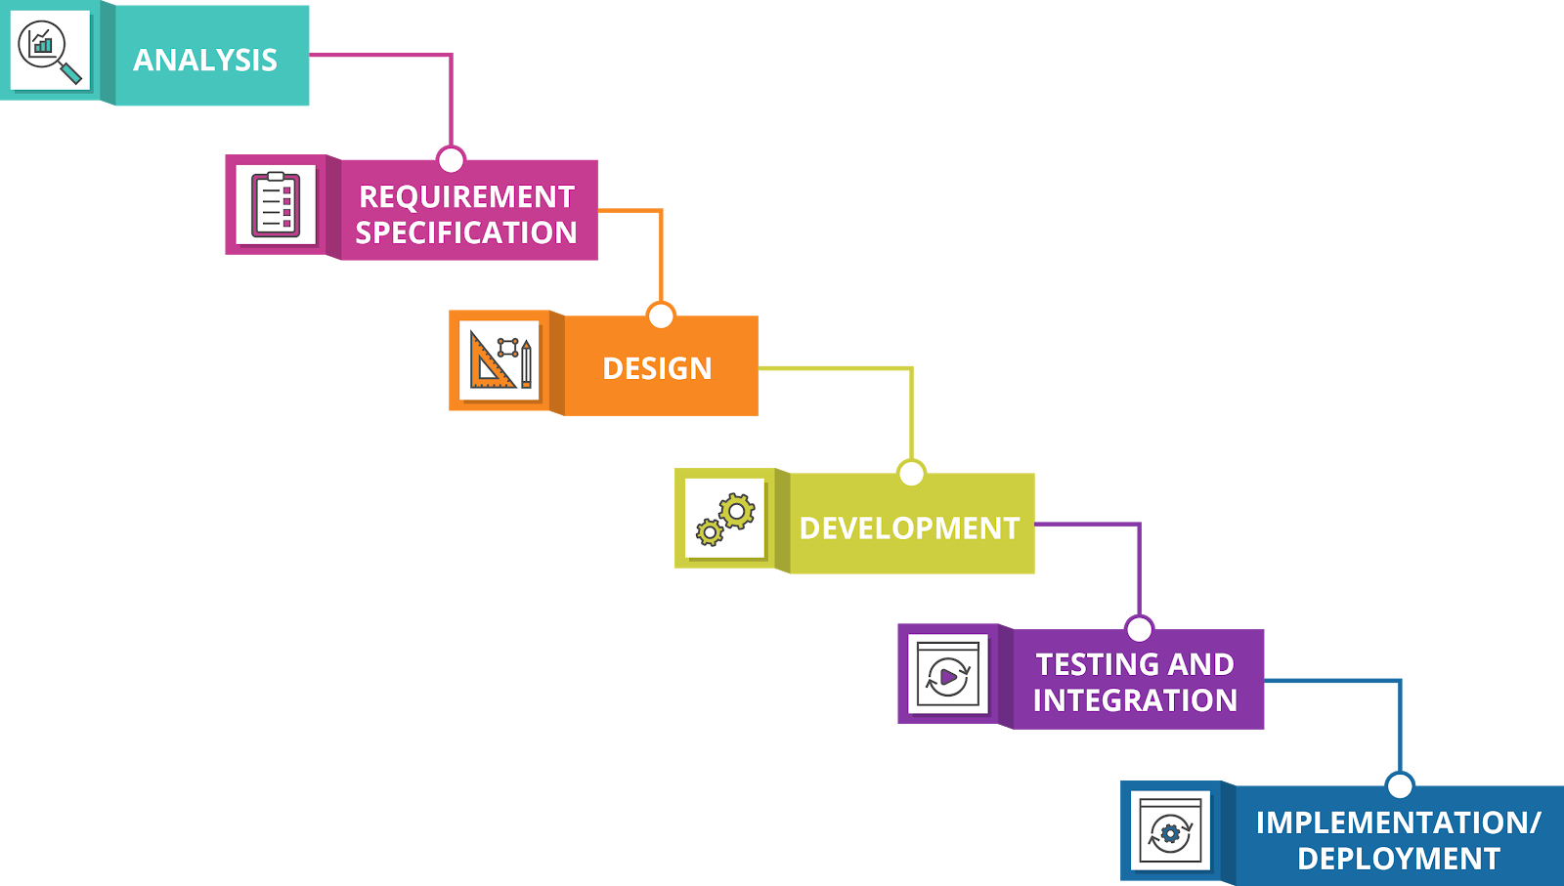

Waterfall

Slide 8
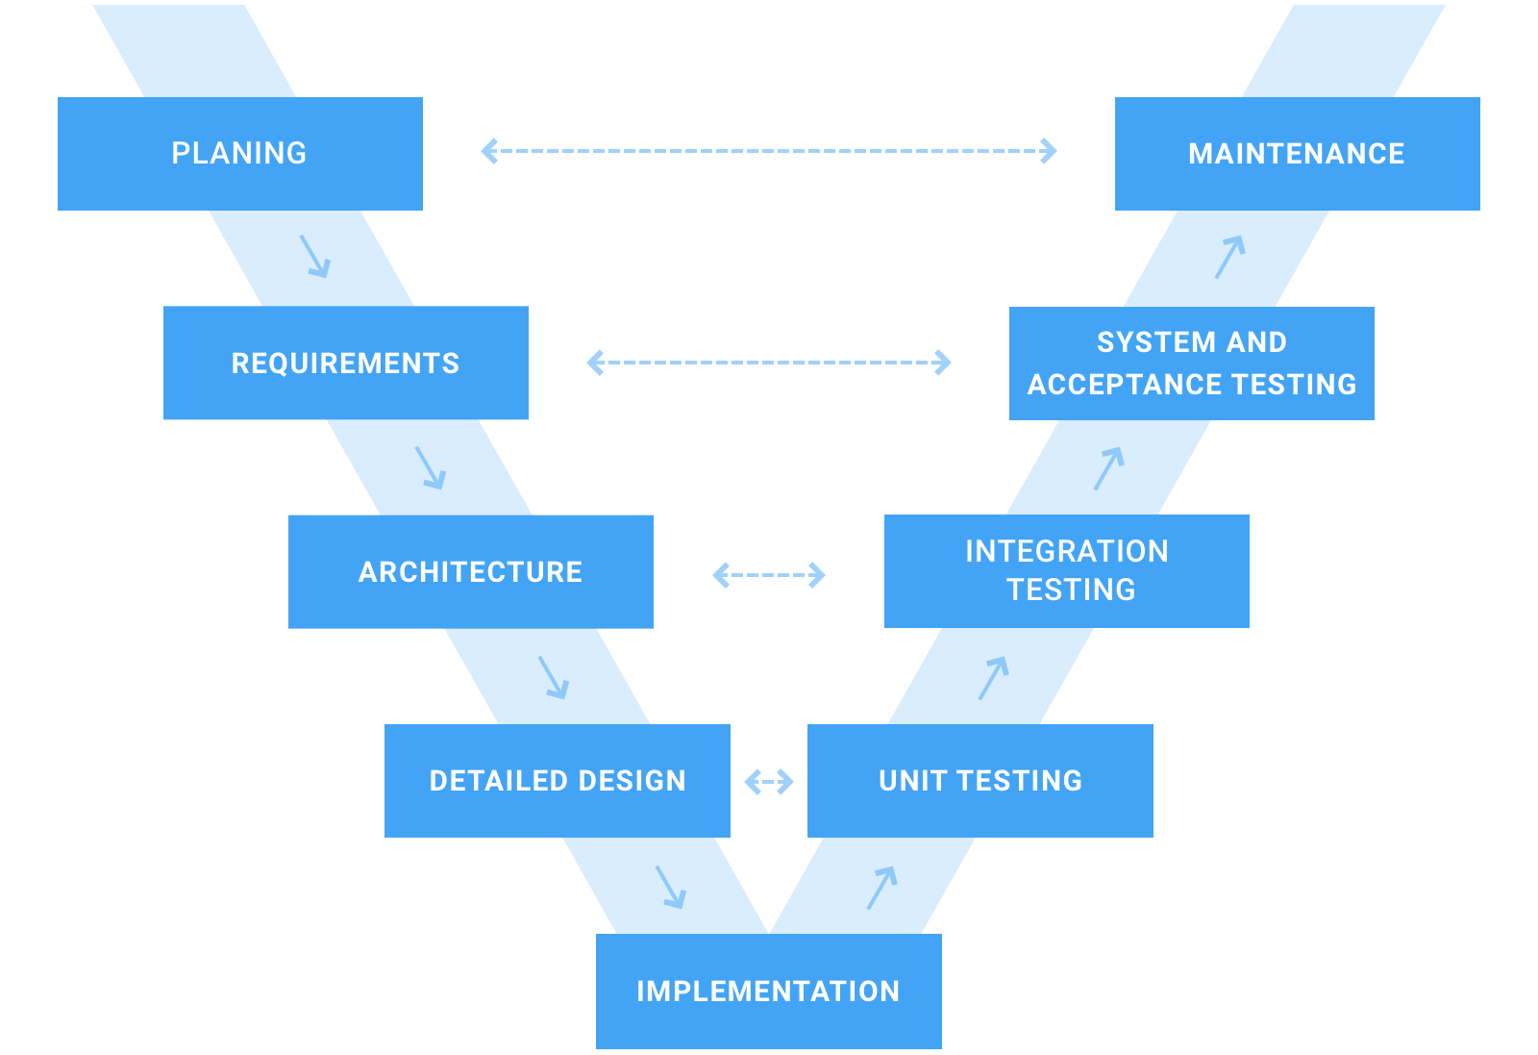
V-Model

Slide 9
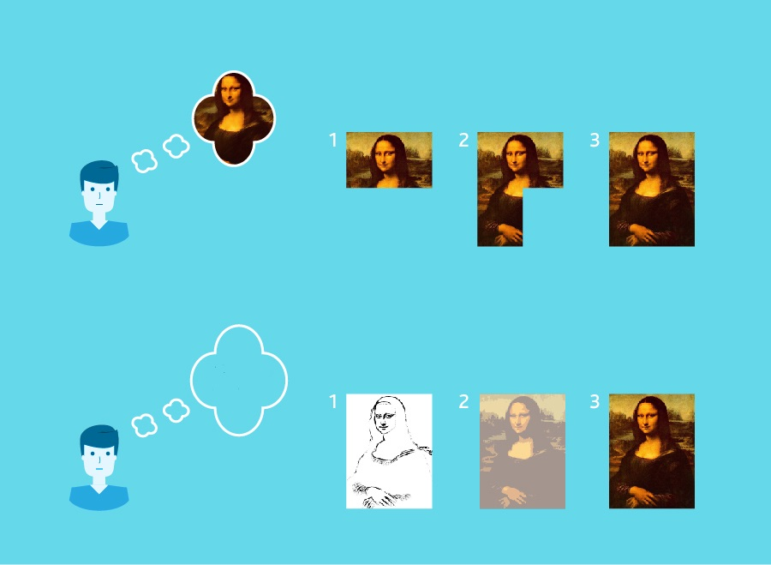
Incremental Model vs Iterative Model
Incremental
Iterative
Working monalisa

Slide 10
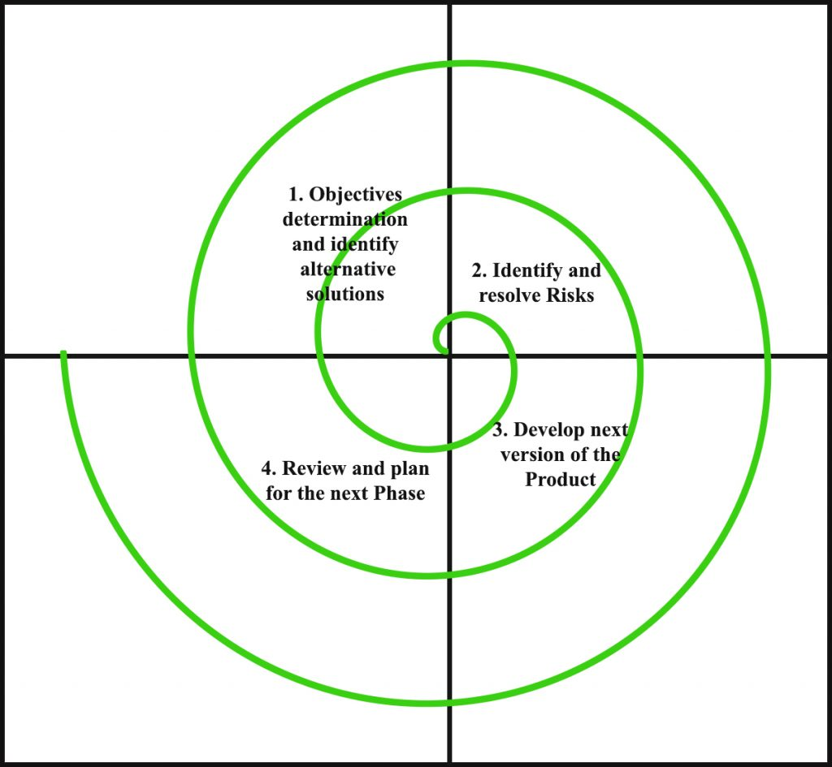
Spiral Model
Version 1
Version 2
Version 3

Slide 11
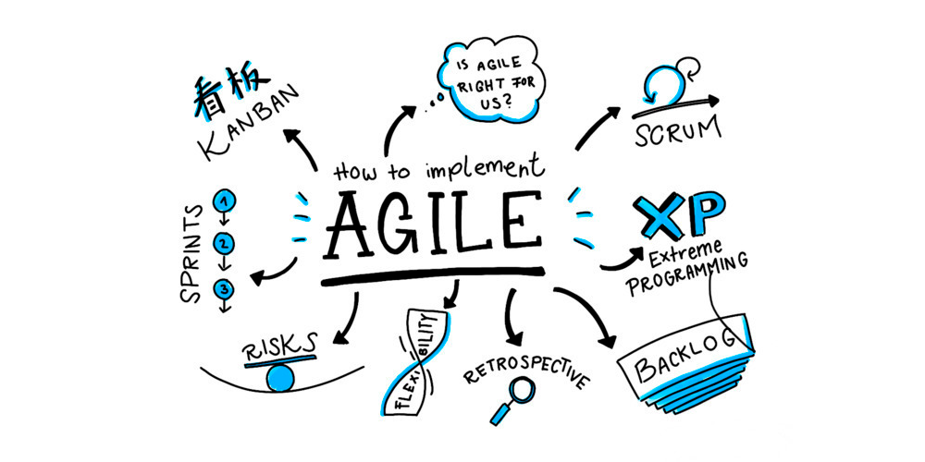
AGILE

Slide 12
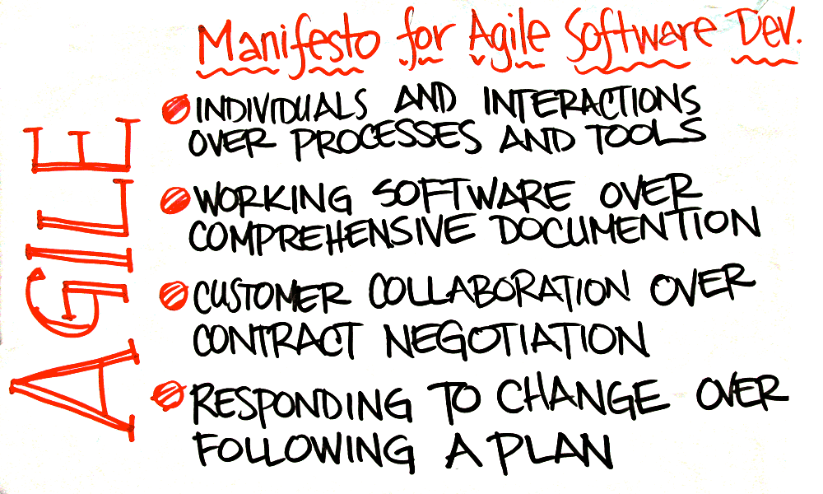
AGILE Manifesto

Slide 13
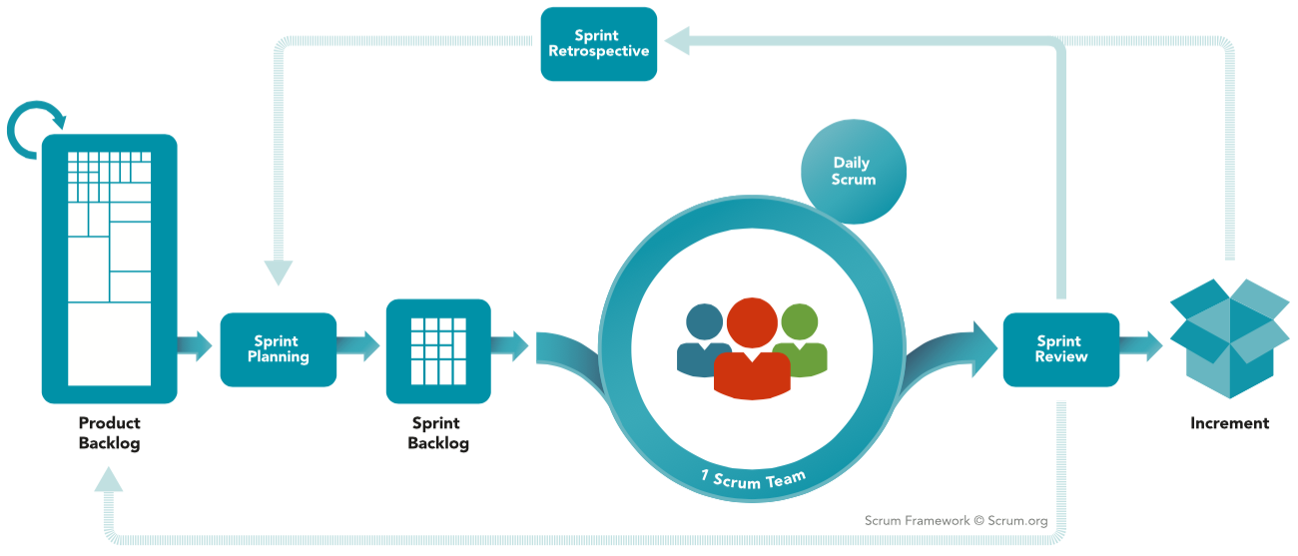
AGILE (SCRUM)

Slide 14
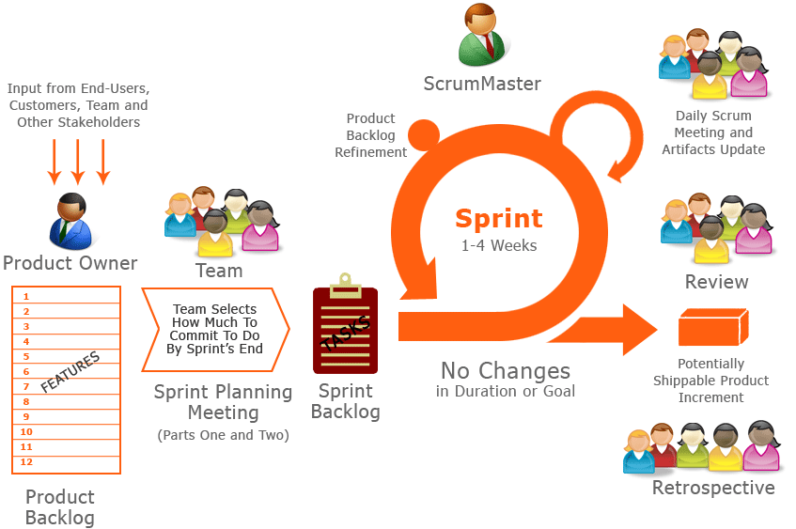
AGILE (SCRUM)
SCRUM is:
Lightweight
Simple to understand
Difficult to master

Slide 15
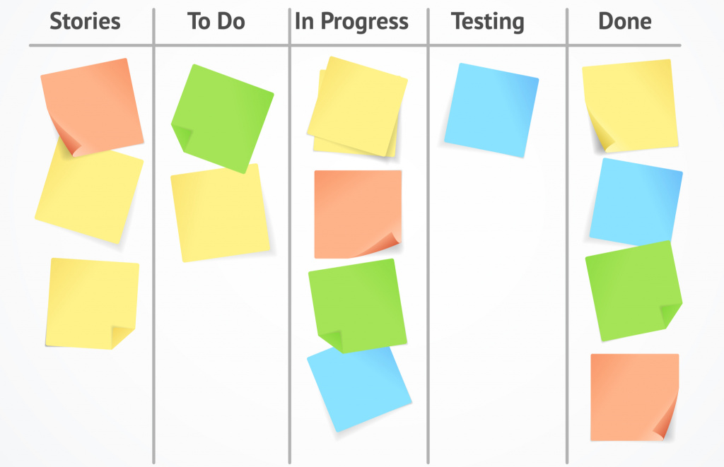
AGILE (Kanban)
Board

Slide 16

Useful links:
https://usersnap.com/blog/software-development-methodologies/
https://www.alliancesoftware.com.au/introduction-software-development-methodologies/
https://www.alliancesoftware.com.au/agile-methodology-software-development/
https://www.scrum.org/resources/what-is-scrum
https://www.digite.com/kanban/what-is-kanban/

Slide 17

Thank You

